Slide 1


Highway Design Manual

Slide 2


Rewrite Overview
Digital Only
Not duplicating other guidance
Updated drawings to current CADD Standards
Chapter 600 – Public Involvement Exception

Slide 3
Assign Chapters
Review Together
SHE Review
FHWA Review
Publishing
Steps
to Success

Slide 4



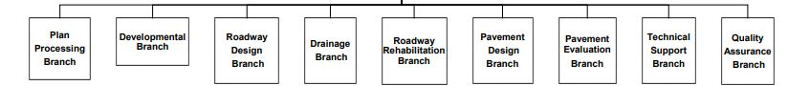
HD-100
Manual use and Philosophy
Emphasizes on flexibility. Only using “SHALL” where need to be.
Does not supersede sound engineering principles by experienced design professionals.
A well thought out design that does not comply with the design criteria is better than a design that merely meets the criteria and is not thoroughly evaluated.
Prioritize the reduction of fatal and serious injury crashes for all users.
Responsibilities of each branch of the Division of Highway Design

Slide 5


HD-200
Updated hyperlinks and processes/submittals.
Funding Requests through FRA for Design and Planning
Funding Requests through KURTS
Intersection Control Evaluation (ICE) Screening as a Predesign Activity.
  Traffic Forecast needs turning movements
Added Intelligent Transportation Systems (ITS) as a Predesign Activity
Interstate Access Justification Report (IAJR)
Added Alternative Delivery Procurement
Drainage Submittals
Professional Services Portal - RFP creation & negotiating contracts

Slide 6
HD-200
Closing consultant contract
Updates to Consultant evaluations
Updated Maintenance of Traffic - TMP
  Deeper explanation on detours
  Use of LEOs (Law Enforcement Officers)
Updated CADD standards including links to workflows and tech support options
Final Contract Plan Submittal deadlines
Distribution of Record Plans and Retainage guidelines
Coordination with Airports and Rest Areas within the project area
Removed Reference to State Highway Engineer Guidance Manual

Slide 7
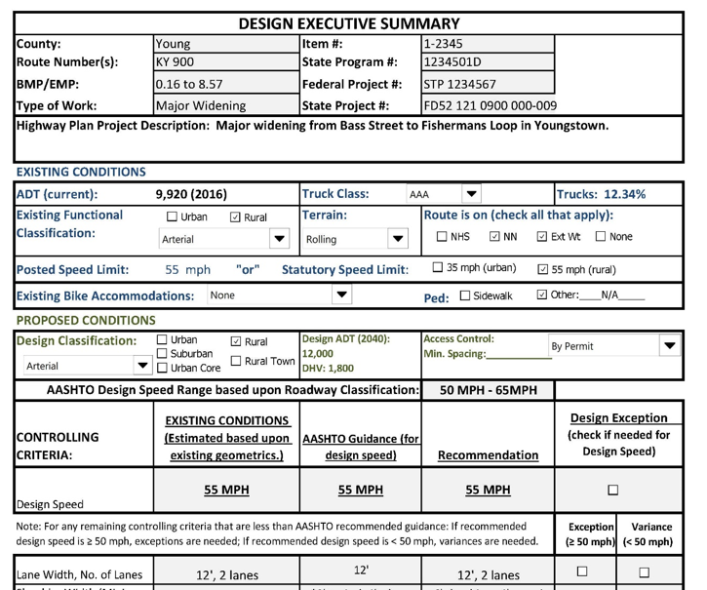
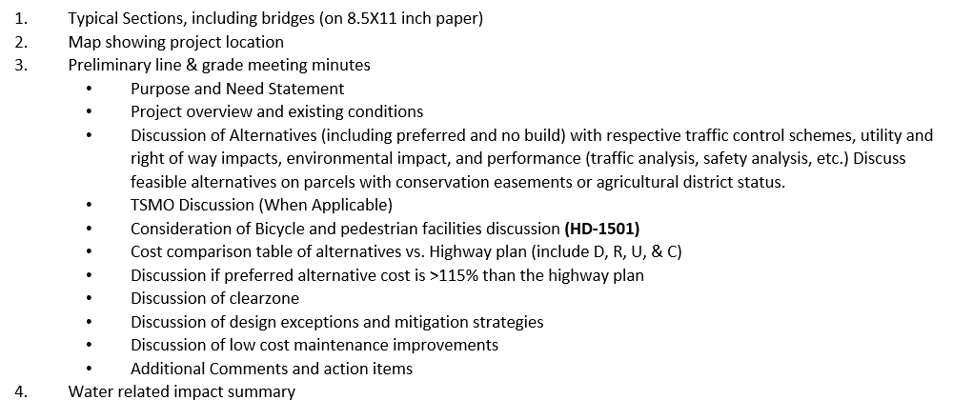
HD-200

Slide 8
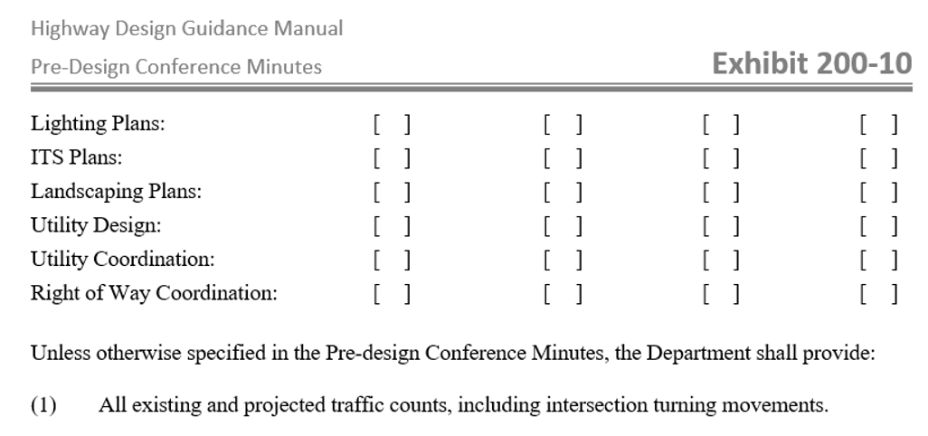
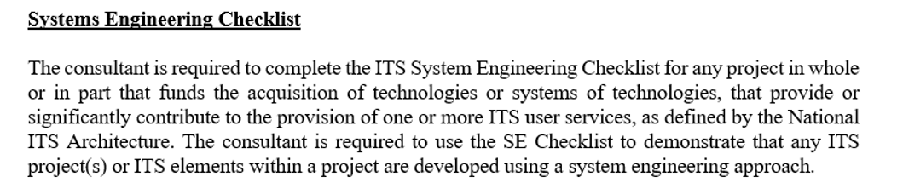
HD-200

Slide 9
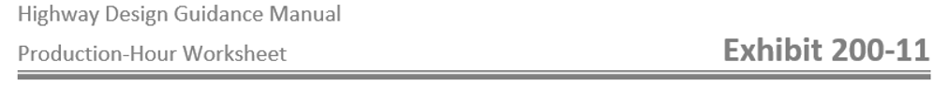
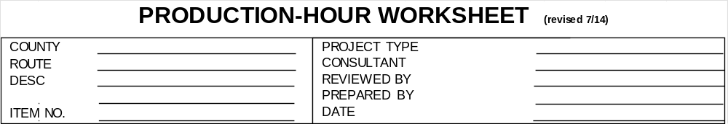
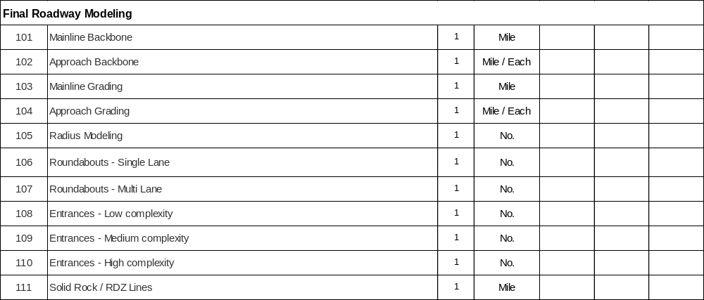
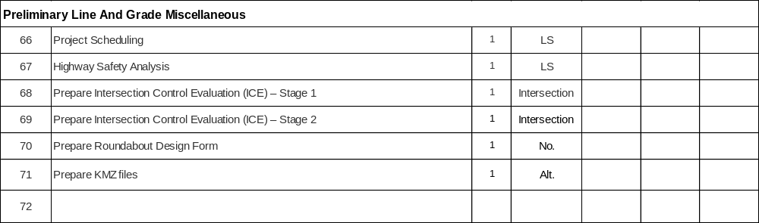
HD-200
C

Slide 10
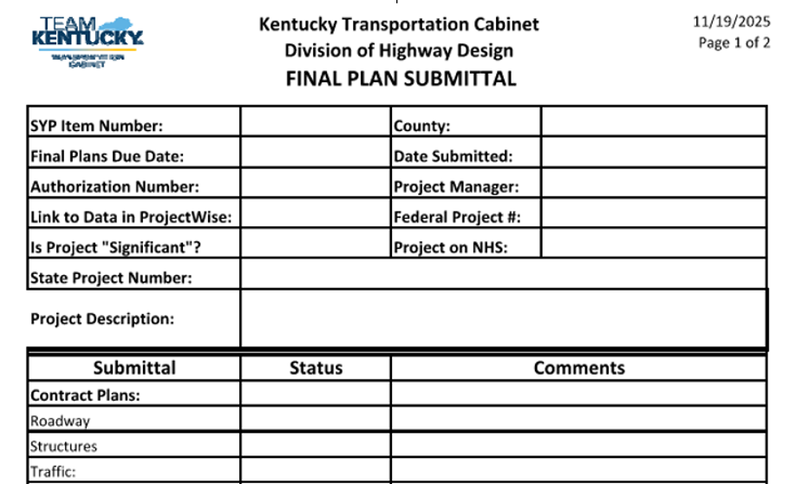
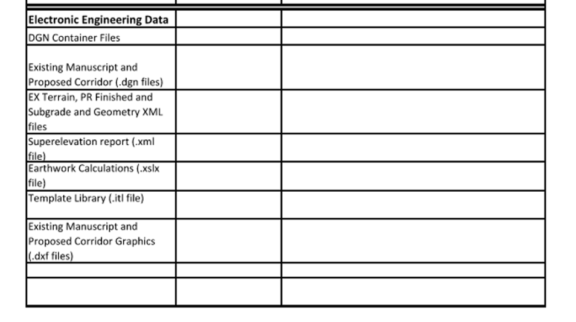
HD-200

Slide 11
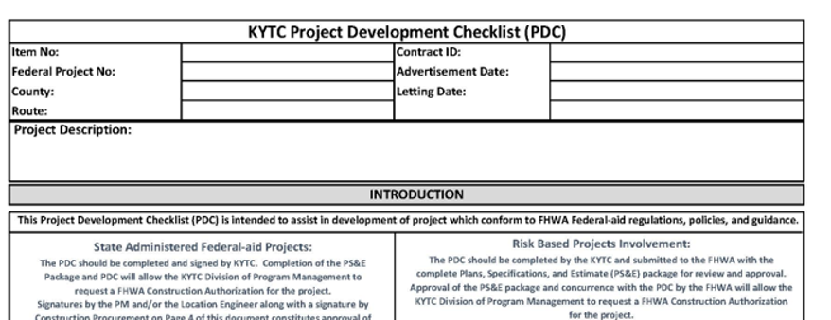
HD-200

Slide 12

HD-300
Removed reference to new Datums coming in the future - Kentucky Single Zone
Added Note on the accuracy of KYTC Real Time Network (RTN)
  should test to ensure accuracy
Clearer language on Utility location procedures
Refusal of entry – Now refers to Design Memos 02-26 ramifications from House Bill 542
Added Structure from Motion (SfM) – software that can extract images from unmanned aircraft
Removed Classification Schema exhibit
Link cleanup

Slide 13

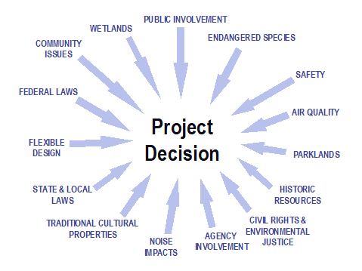
HD-400
Project Decision Considerations
COMMUNITY IMPACT ASSESSMENT

Slide 14
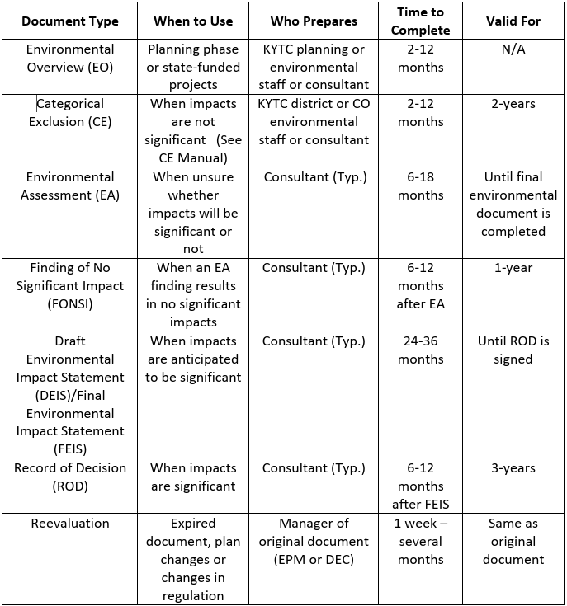
HD-400
NEPA Document Types into Table

Slide 15

HD-500
Went from 52 to 57 separate activities covered by Nationwide Permits
Went from 5 to 6 routinely used
  #3 Maintenance,
  #13 Bank Stabilization,
  #14 Linear Transportation Projects
  #6 Survey Activities
  #15 USCG Approved Bridges
  #33 Temporary Construction, Access and Dewatering
Updated to follow the Environmental Analysis Guidance Manual
More detailed list of Permit Drawing requirements.
Removed the Definition of SIGNIFICANT NEXUS and Sheet Cell Exhibit 500-02

Slide 16

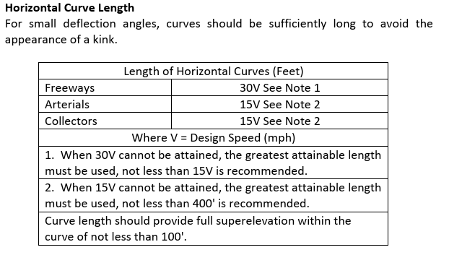
HD-700
All exhibits completely redone
  Context Classifications
  Updated CADD drawings
Yes, we corrected Connector to Collector
Added a table for Horizontal Curve Length

Slide 17
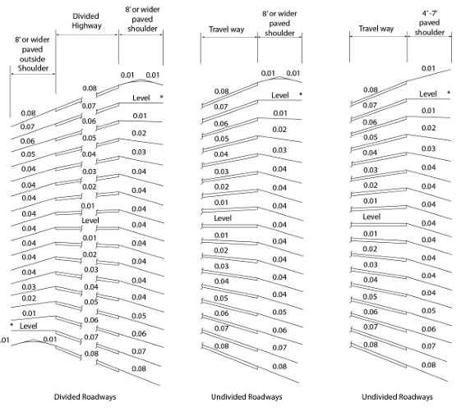
HD-700
Updated our Superelevation break on shoulders
Updated break on Typical Section Exhibits

Slide 18
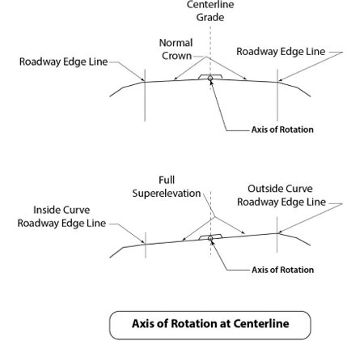
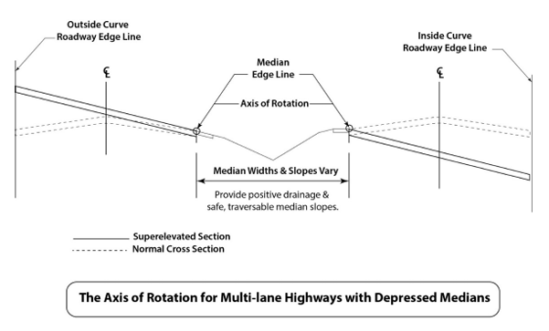
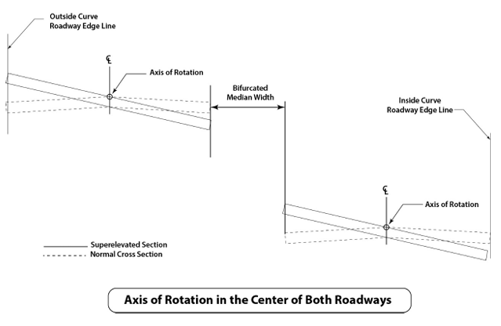
HD-700
Added Visuals – Axis of Rotation

Slide 19
HD-700
Updated Project Types
  New Construction
  Reconstruction
  Construction
Typical Sections need to include Pedestrian & Bicycle Accommodations
Moved away from Earthen Shoulder to Usable Shoulder
Risk Based Project Involvement (RBPI)

Slide 20
HD-700
Rearranged Chapter 703 – Design Controls
  Design Functional Classification
  Context Classification
  Topography
  Design Speed
  Operational and Safety Performance
  Volume of Traffic
Chapter 703 – Other Factors Affecting Design
  Moved Project Type, Design Vehicle, Environmental
  Elevated the importance of All users

Slide 21
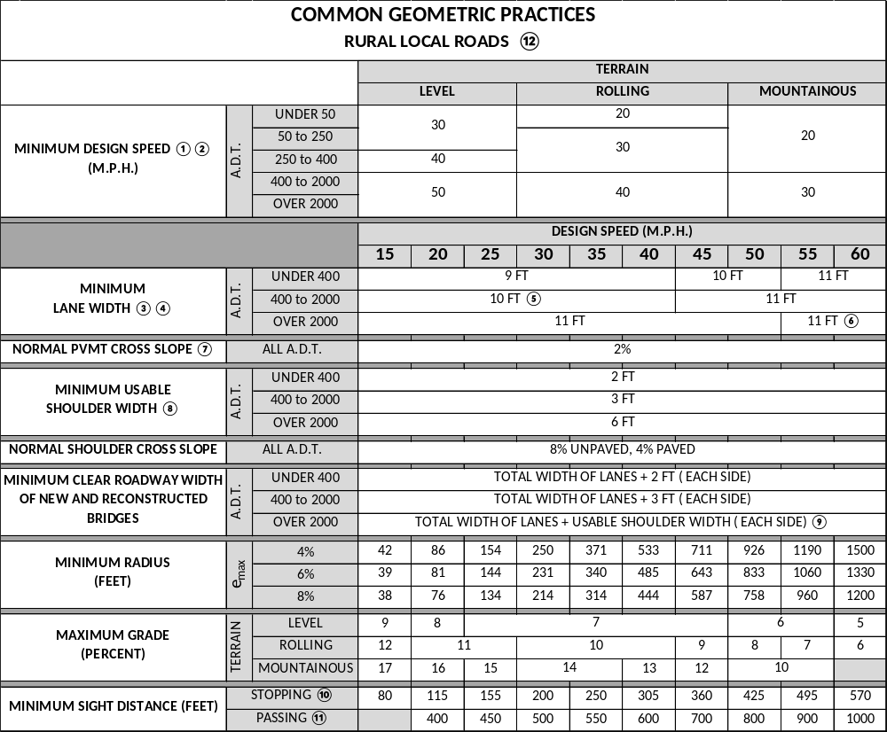
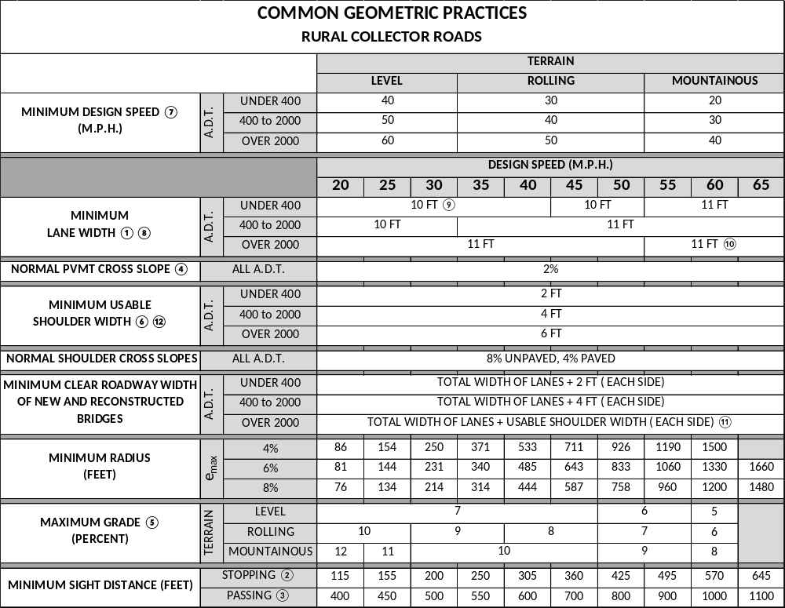
HD-700

Slide 22
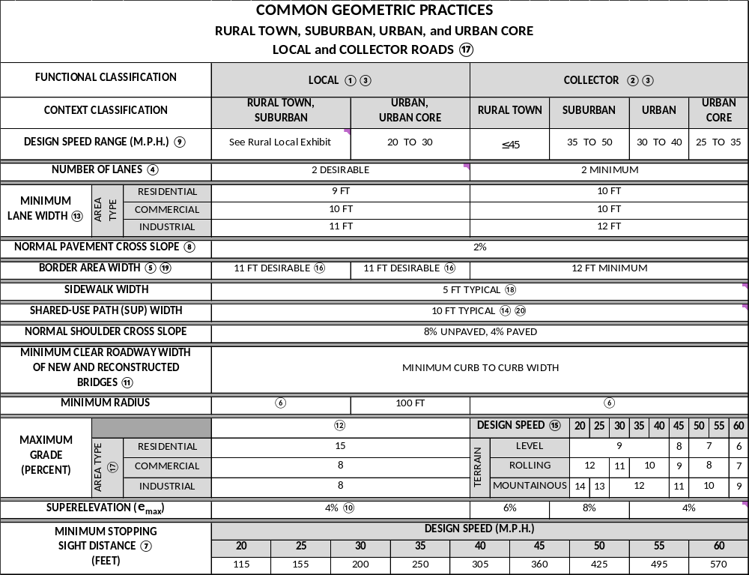
HD-700

Slide 23
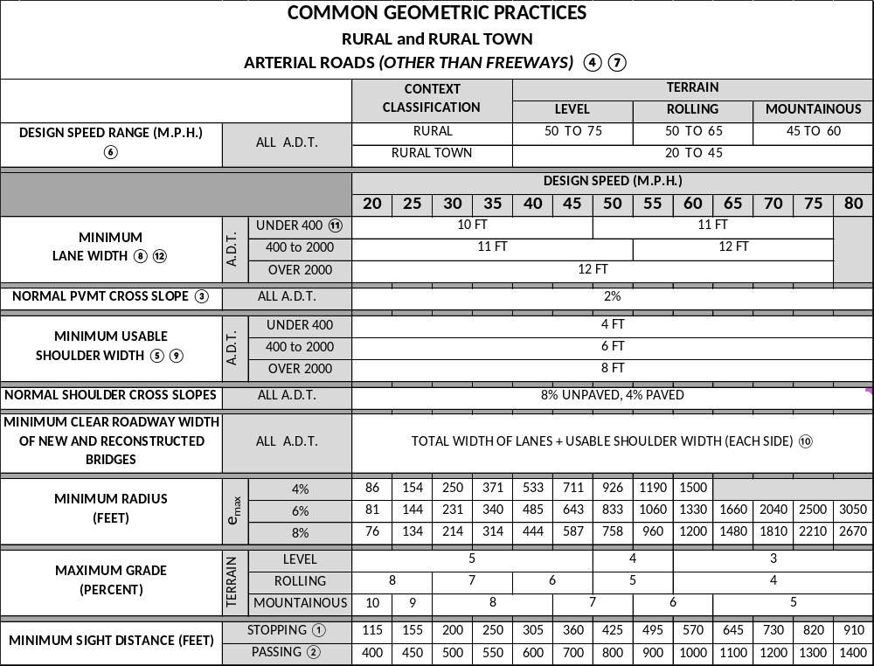
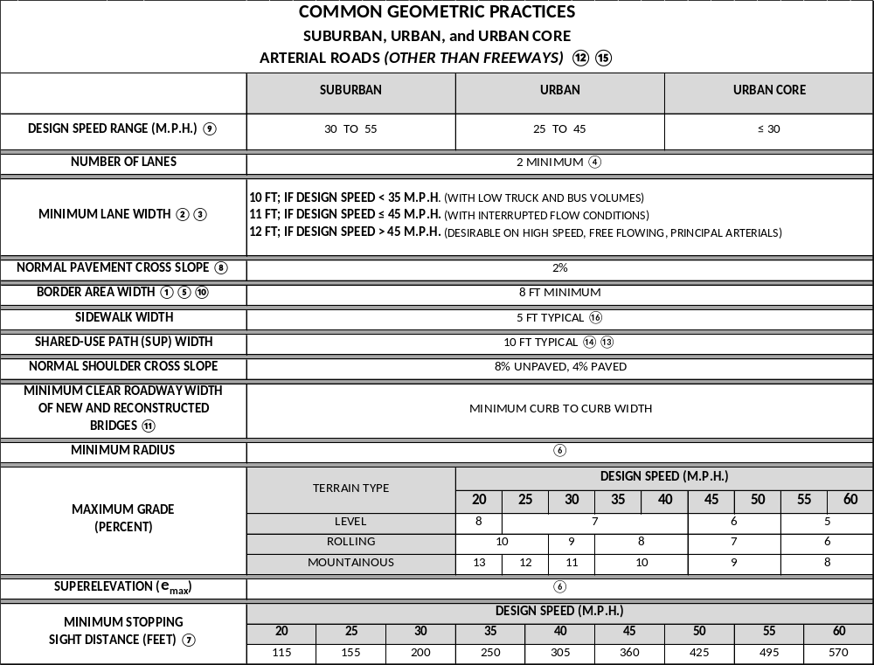
HD-700

Slide 24

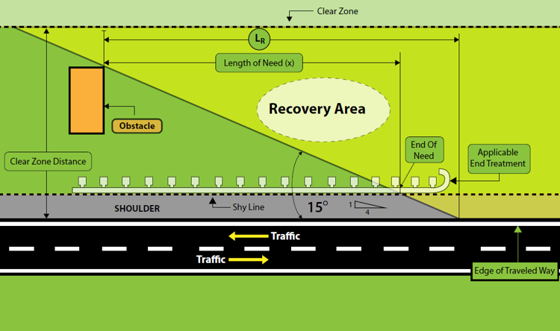
HD-800
Updated Length of Need Visual to include Shy Line
  Shy Line vary on Design Speed (Table 5-7)
  LON - First non-breakaway portion
Added Urban and Suburban Context to Curbs
Removed NCHRP 350 for Barriers & End Treatments
Midwest Guardrail System (MGS)

Slide 25
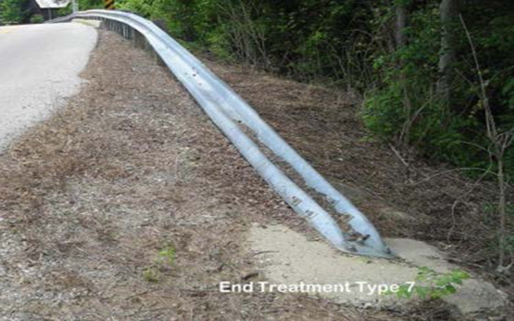
HD-800
Guardrail End Treatment Type 7 SHALL not be used on high-speed NHS routes.
  Not crashworthy end treatments
  Last resort on low-speed/low-volume roads when crashworthy end treatments will not function properly.
  They can be considered on low-speed/low-volume facilities when an adequate recovery zone is unavailable
  Where conditions preclude the desired performance of other end treatment types.
  Appropriate justification should be retained in the project file

Slide 26

HD-900
Design Considerations that match Complete Streets Approach
Included ICE analysis
Pointing to Roundabout Guidance Manual
Alternative Turn Lane Designs
  Medians with U-turn Crossover (MUT)
  Reduced Conflict U-turn (RCUT)
  Jughandle (Quadrant Intersection)
  Displaced Left-Turn
  Roundabouts

Slide 27
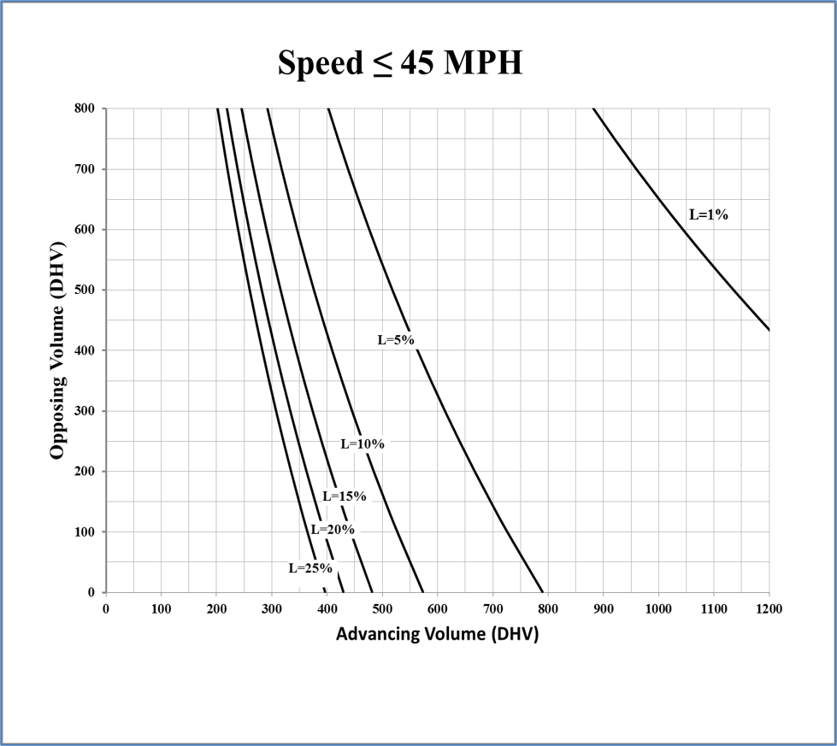
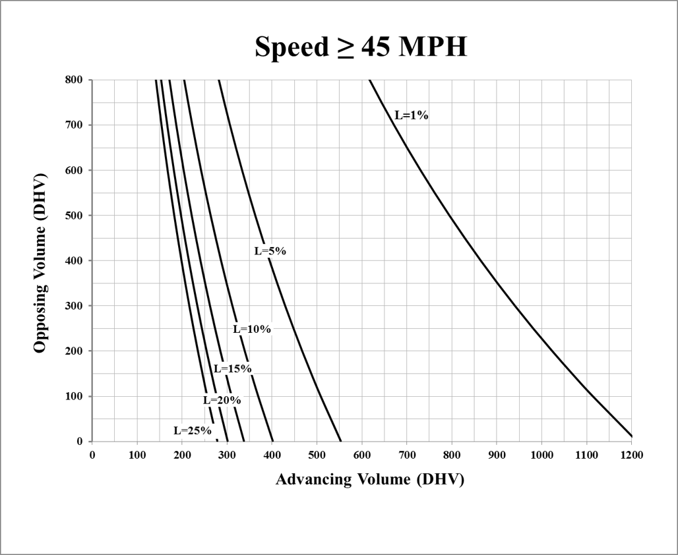
HD-900
Left Turn evaluation – Uncontrolled approach

Slide 28
HD-900
Interchanges
  Review the area of influence surrounding the interchange and how it can alter the traffic flow of the entire network. Including close access points that may impact the safety and performance of the interchange.
Accommodation for all users
Interchange Types - Pointed to KYTC’s SAFERoad Solutions
Geometric Layout sheet review - FHWA

Slide 29
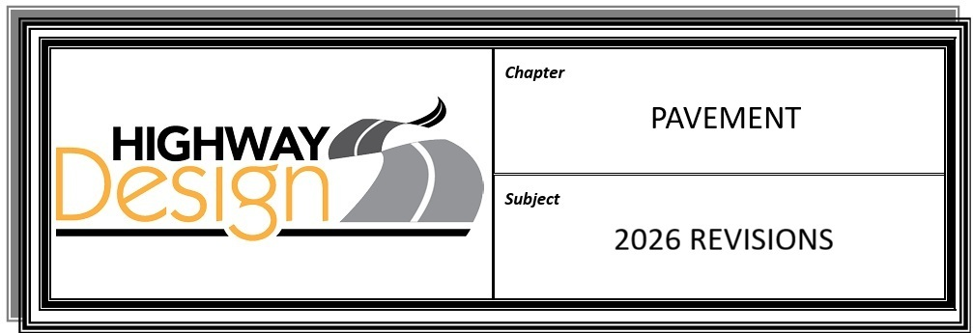

HD-1000
Pavement Design Submittal using Web application
  Removed Pavement Design Request Form Exhibit
Surface Pavement – 1- ½ inch

Slide 30

HD-1100
Expanded on Access Control
  By Permit
  Partially Controlled
  Fully Controlled
Deeper understanding of Frontage/Backage Roads
  Backage Roads = Reverse Frontage Roads
Updated Permits Manual Chapter #’s

Slide 31


HD-1200
Conceptual Signing plans shall be delivered the District Traffic Engineer prior to the joint inspection
All other sign supports shall be designed in accordance with the Division of Traffic Operations Sign Standard Detail Sheets.
SHALL

Slide 32

HD-1300
Permanent right of way shall be acquired in Fee Simple.
Removed → Temporary Easements for drainage structures (yard drains, etc), little impact on roadway drainage.
Legal descriptions shall state that permanent easements are for perpetual maintenance
Unused parcel #’s should be removed from the summary sheet
Right of Way Monuments → Monumentation on property lines should be avoided.

Slide 33
HD-1300
ROW Plan submittal includes:
  Cross Sections
  Pipe Sheets
  Proposed right of way including bearing and distance
  Entrances including material and designation
  Include lateral lines
Layout Sheet shall not reference type of work
Plan and Profile sheets should not be aerial overlay or KMZ
Legal descriptions need to match Permanent ROW and Permanent Easements

Slide 34
HD-1300
Cemeteries
  Separate Survey and needs to be submitted with ROW plans
  Scale needs to be big enough to show the details of the graves
Excess Property → “No Access Provided”
Along with Source deeds and Plats don’t forget PVA tax cards
Right of Way Revisions
  Required with Change of Plans or during negotiations
  Capture multiple changes
  Don’t wait too long

Slide 35
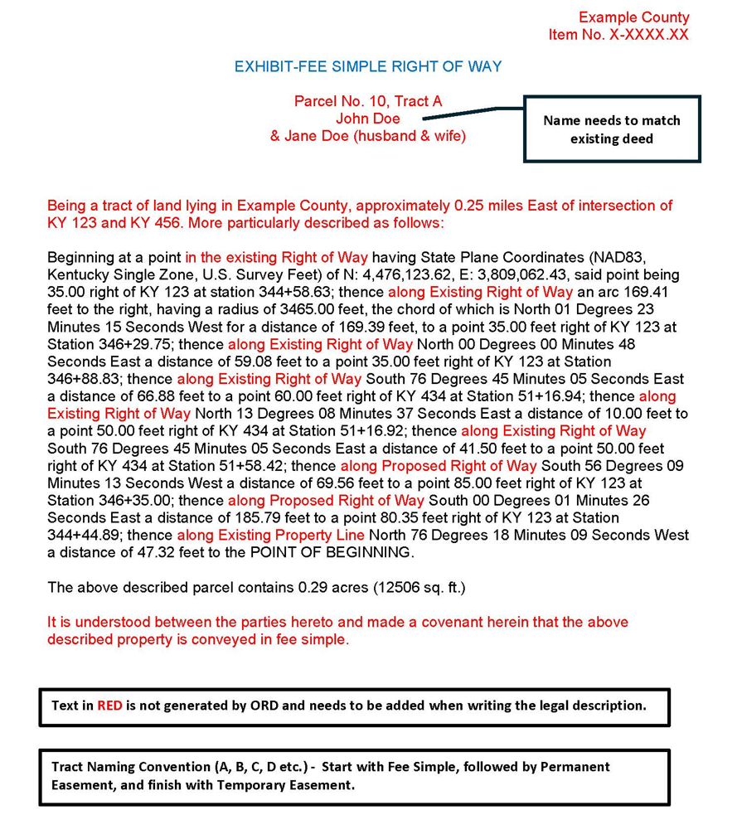
HD-1300
Deed Descriptions Exhibits
Updated CADD Exhibits
  Plan Sheet
  Building Removal Temp Easement
  Summary Sheet
  Strip Map
  Layout Sheet
  Revision Sheet

Slide 36


HD-1400
Updated Links
Emphasis on early coordination with Railroad Companies

Slide 37


HD-1500
Complete Streets, Roads, And Highways Manual
AASHTO’s Guide for the Planning, Design, and Operation of Pedestrian Facilities
Public Right-of-Way Accessibility Guidelines (PROWAG)
AASHTO’s Guide for the Development of Bicycle Facilities
DES Documenting

Slide 38
Delays
House Bills
Evolution of Guidance
Not enough stickers
Patrick Perry
Trainings

Slide 39
Thank You!

